Slide 1
GAMEFRAMEWORK
Soundmanager
ServerManager
LobbyScene
Scene
OBJECT MANAGER
OBJECT MANAGER
OBJECT
Physics
Graphics (directx12)
Animation manager
Mesh
Shader
Animaition
IASET
HLSL

Slide 2
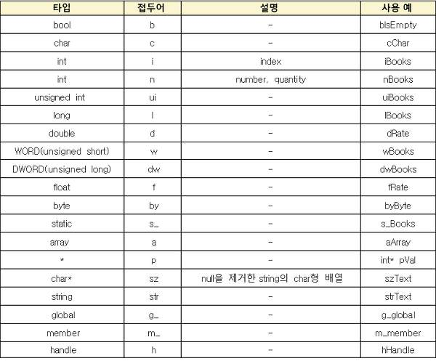
코드 컨밴션

